Slide 1
Nutrition Interventions
Montse Escruela Cabrera – Nutrition Advisor MSF OCBA
September 2022

Slide 2
Introduction

Slide 3
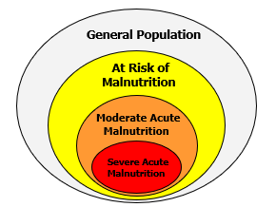
Defining a Strategy 1/3
Food security and nutritional context analysis
    Nutrition Security Surveillance System based on three pillars
      Food Security Indicators
      Nutrition and Health Indicators
      Context Indicators
Choice of target population
    In an emergency context, who needs food?
      Everyone!
      Vulnerable populations: U6m; U2y; PLW; elderly; chronical diseases, etc
Type of intervention
    Prioritization
    Available Resources

Slide 4
Defining a Strategy 2/3
Food security situation
Nutritional situation
Target Population(s)
Available resources
TYPE(S) OF INTERVENTION(S)

Slide 5

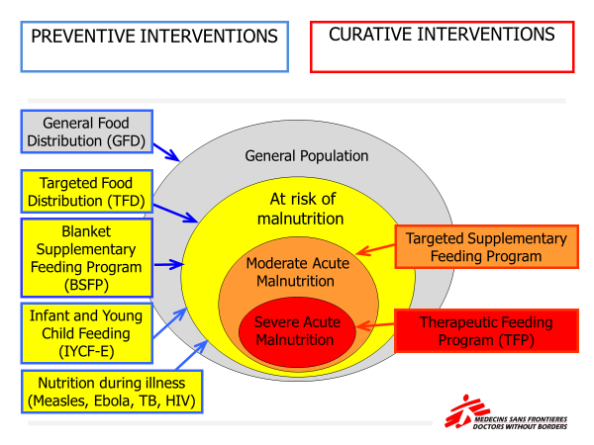

Defining a Strategy 3/3
note that down
WFP is a key partner for:
GFD: general food distribution
TFD: target food distribution
BSFP: blanket feeding
SFP: supplementary for MAM
UNICEF is a key partner for:
IYCF-E: infant feeding
TFP: therapeutic for SAM
Other Key Nutrition Partners:
Ministry of Health
Local NGOs
International NGOs

Slide 6
Preventive Interventions

Slide 7
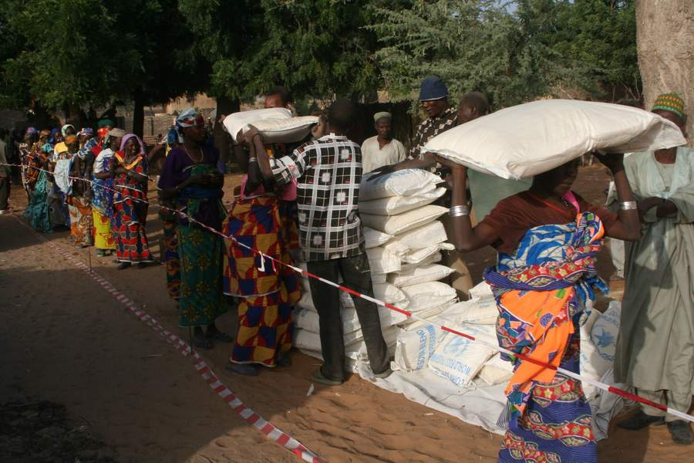
General Food Distribution (GFD) 1/3
For who
  All members of the general population
Objectives
  To cover basic food needs of the whole population
  To maintain + restore regular livelihood
  → prevent malnutrition and death
How
  Full food ration (Adequate quantity and quality)
  Distribution equitable with local, governmental collaboration
  Ration culturally accepted
When to initiate?
  Severe decline in food availability or accessibility.
  Before a nutritional situation deteriorates.
Notes:
Typical contexts are: natural disaster, rapid population displacement due to conflict, population persistently food-insecure.

Slide 8
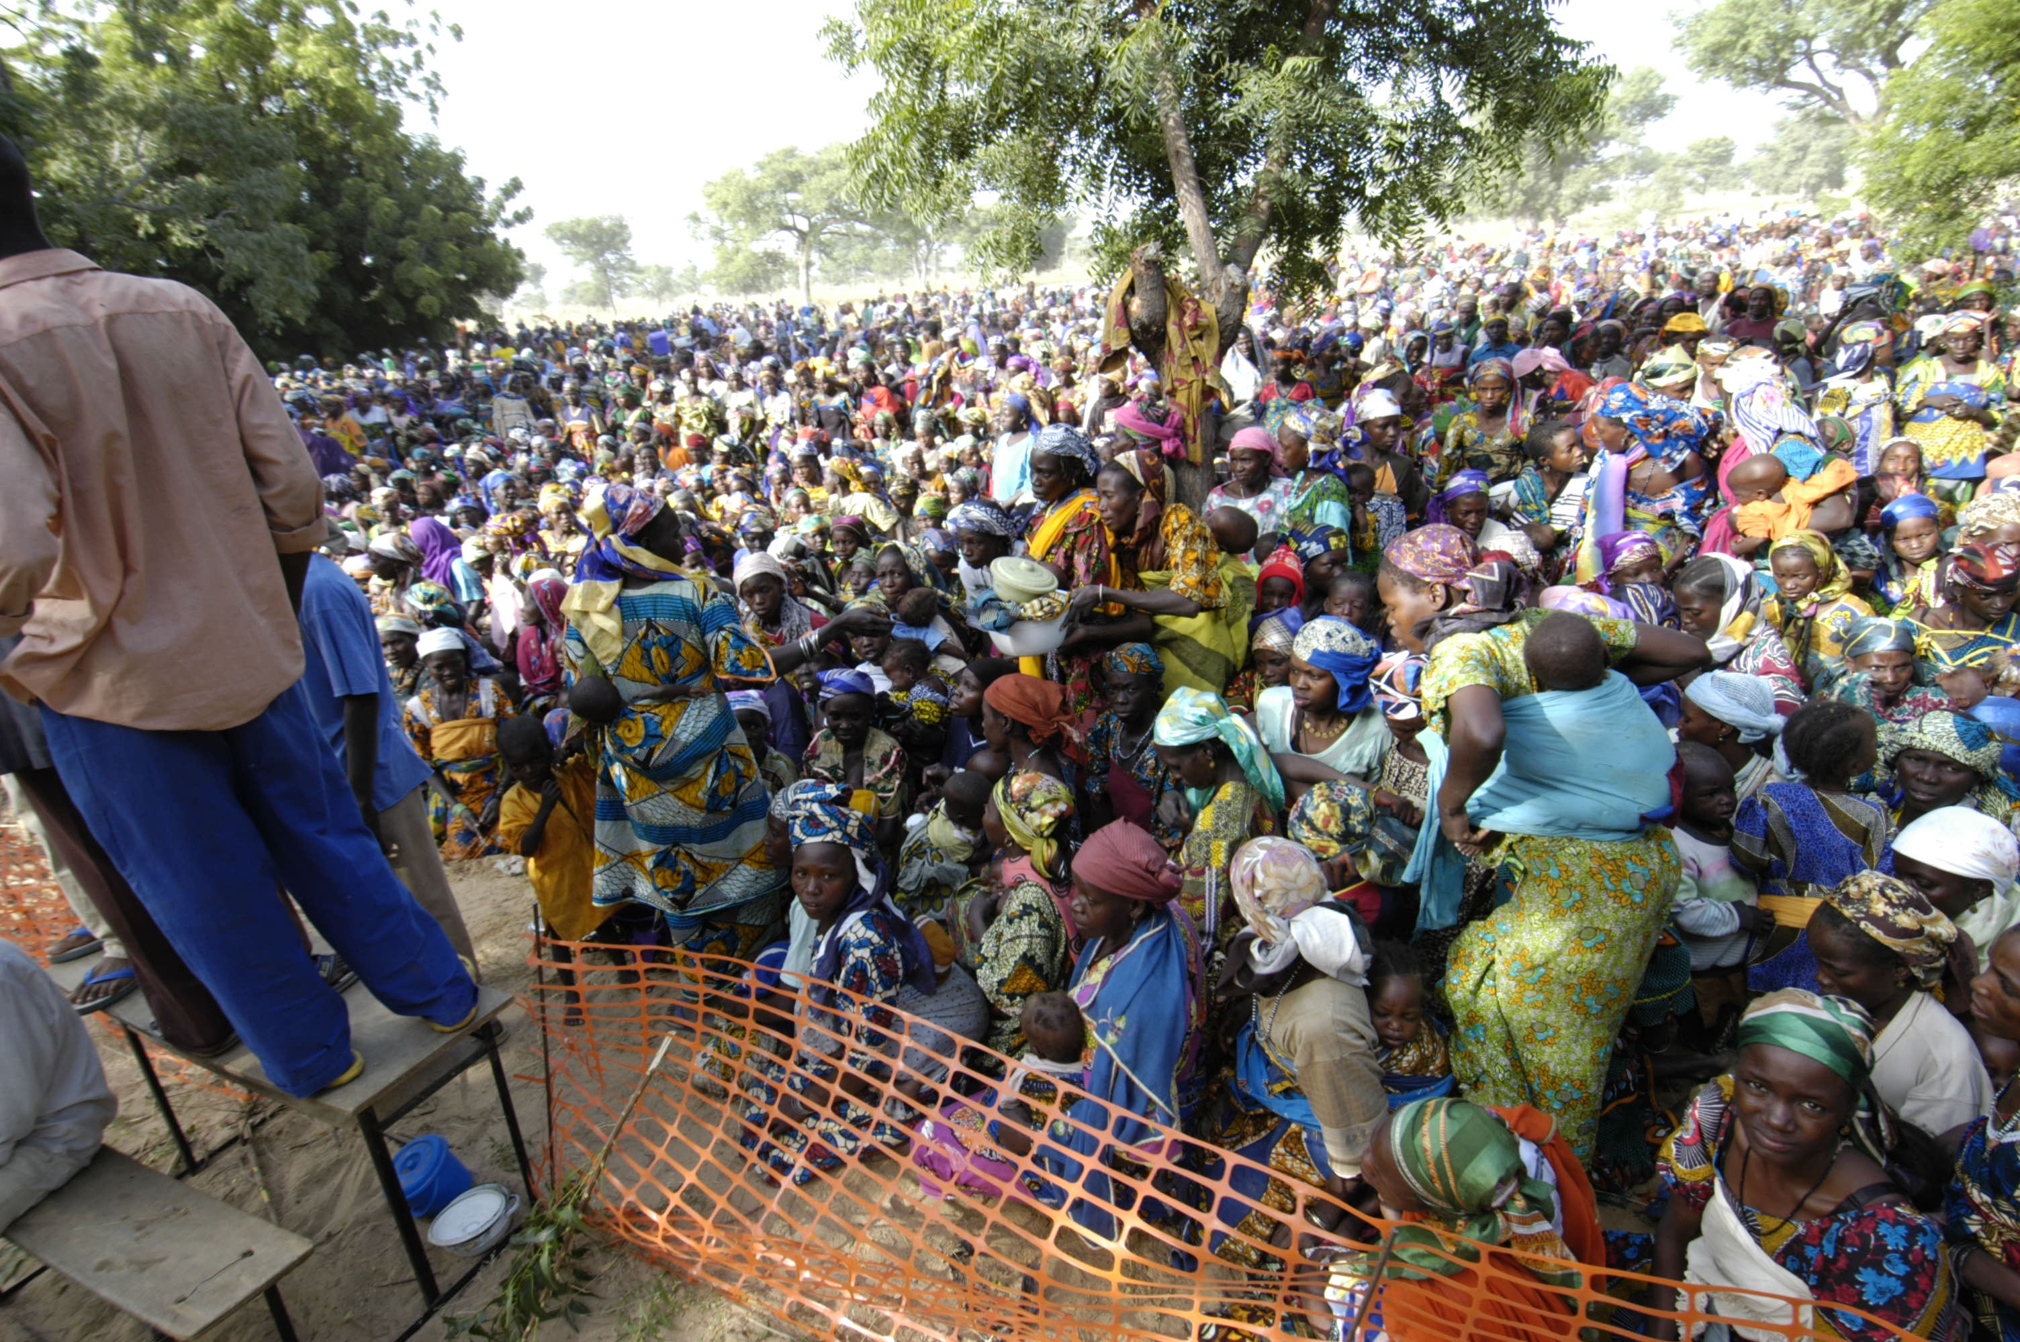
General Food Distribution (GFD) 2/3
MSF is
rarely involved
in food aid
operation
Political challenges
A tool for manipulation or for controlling people
Food aid should be efficient, impartial, equitable, transparent, and accountable
Financial challenges
Food aid is extremely expensive
An in-depth analysis of the situation permits to develop a range of arguments to donors
Logistical challenges
Food aid is a high priority in emergency settings to save life
Food should arrive (procurement&transportation) and be distributed quickly
Human challenges
To be able to set up the operations (means)
To communicate with government, leaders, partners, donors, families…

Slide 9
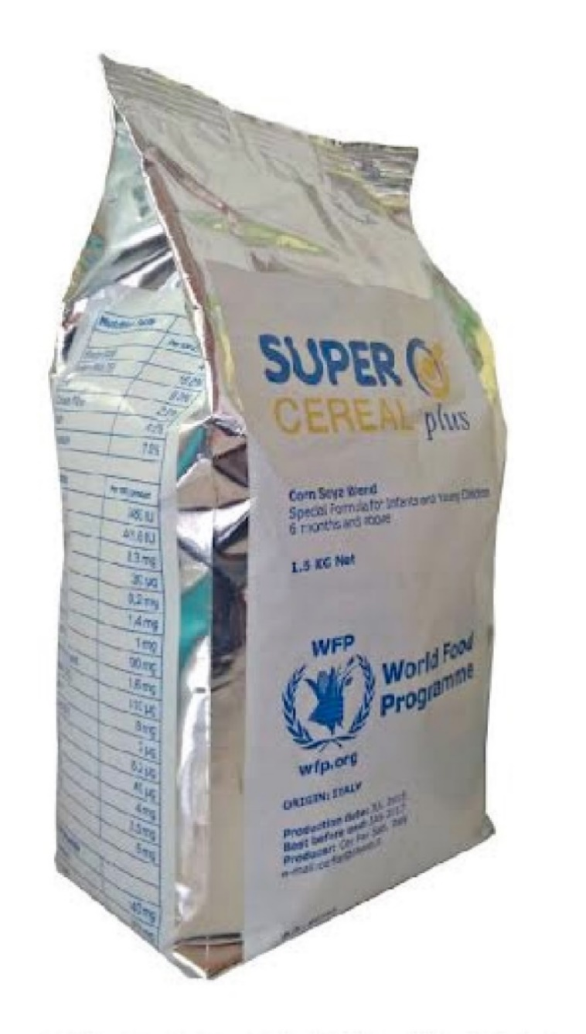



General Food Distribution (GFD) 3/3
note that
MSF involvement in GFD is rare except for support on
Ensure proper nutrition for vulnerable groups. I.e: children under 2 years, PLW: Supercereal + or Lipid-rich Nutrient Supplement (LNS)
Food monitoring
Lobbying & advocacy
Other GFD approaches
Distribution of food vouchers or cash
Favours the local economy
Families buy/consume food they actually like
Easier for logistics
But!
Security issues
Money may not spent on food (our right to decide?)
May cause food prices to increase

Slide 10
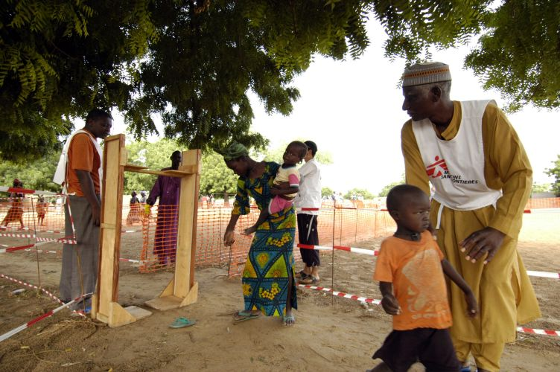

Targeted Food Distribution (TFD)
For who
  Vulnerable households
Objectives
  To prevent deterioration of nutritional status
  ↑ food availability /accessibility rapidly
How
  A short-term intervention (3 to 4 months max.)
  Partial food ration (minimum 500 kcal/person); ration for all family members
  With strong lobby simultaneously
When to initiate:
  Population’s food availability and accessibility has seriously decreased.
  GFD is inadequate or ineffective.
Notes:
Vulnerable Households: Economic vulnerability
Household with vulnerable members (pregnant, lactating women, elderly, orphan)
Household with children enrolled in Therapeutic Feeding Programmes (protection ration, discharge ration)

Slide 11
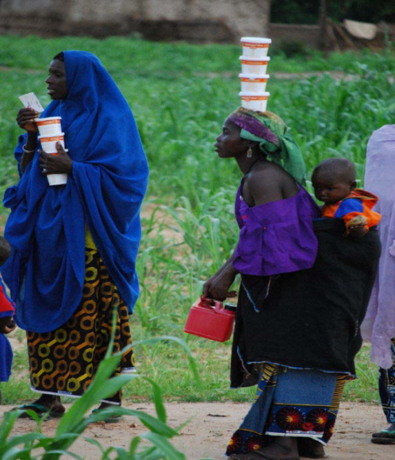
Blanket Supplementary Feeding Programme
For who
  Vulnerable individuals (<5y, pregnant and lactating women, elderly)
Objective
  To give a nutritional complement (to improve quality) to a selected group to prevent deterioration of nutritional status
How
  Monthly distribution of food supplement (250-500 kcal/day)
  With complementary actions: deworming, vaccination, nutritional screening
  Complementary with other structures (health center, pre-post natal consultation…)
When to initiate:
  High prevalence of acute malnutrition
  Hunger gaps
  Family diet is not sufficient and  incidence of acute malnutrition +  child mortality.

Slide 12
Infant and Young Child Feeding in Emergencies (IYCF-E)
For Who
  Infants and their mothers or caretaker
Objective
  Prevention of morbidity, mortality and development of malnutrition among young infants
How
  Include ALWAYS in the needs assessment during emergency
  Dedicated structure and staff IYCF support and screening
  Can be added to existing mental health programmes
When to initiate:
  In situation of population distress in emergencies or following natural disasters.
Notes:
Rational: In situation of population distress in emergencies or following natural disasters, infant feeding is expected to be affected and reduced
Goal: Strengthen feeding practices which can have an effect on morbidity, mortality and the development of malnutrition among infants
Activities provided in the tents:
Advice on breast feding practices
Psychological support when needed
Group discussion and exchange of experiences between mothers.

Slide 13
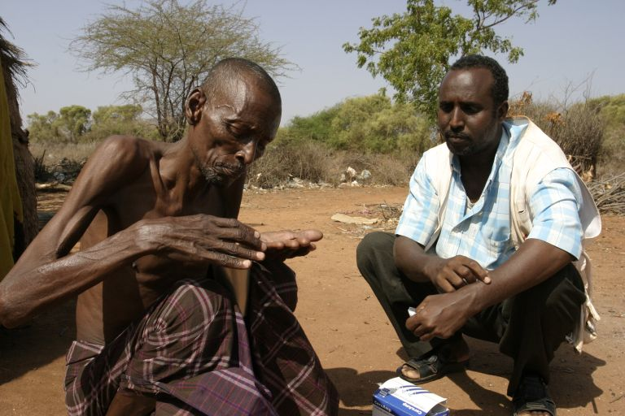
Nutrition for sick patients
Who
  For patients diagnosed with specific illnesses which could affect their nutritional status
Objective
  To support groups with specific needs
    HIV / Aids patients
    TB patients
    Measles, shigellosis, ebola patients…
How
  With disease-specific support

Slide 14
Curative Interventions

Slide 15
Therapeutic Feeding Programme (TFP)
For Who
  Individuals (generally children <5y) with SAM
Objective
  To reduce mortality among severely malnourished individuals and treat SAM by providing adapted medical and nutritional care
How
ATFC
ATFC
ITFC
ITFC: Inpatient Therapeutic Feeding Center (complicated SAM)
ATFC: Ambulatory Therapeutic Feeding Center (uncomplicated SAM)
ATFC

Slide 16
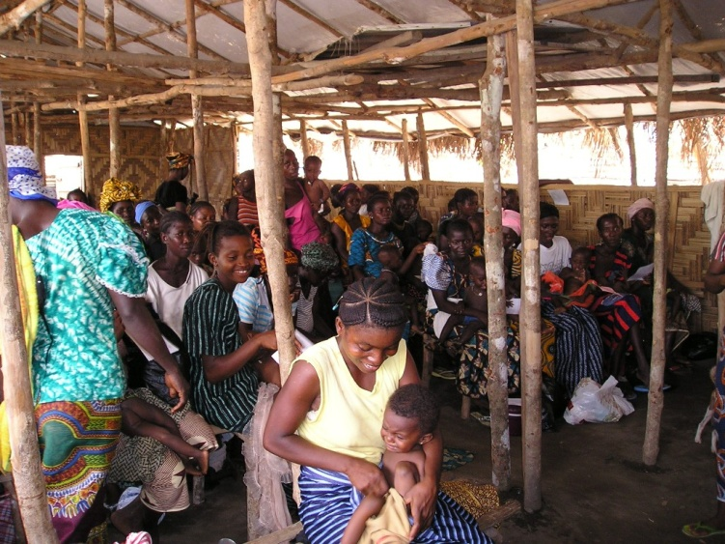
Targeted Supplementary Feeding Programme (TSFP)
For Who
  Individuals (generally children <5y) with MAM
  Other groups can be targeted: PLW, adolescent.
Objective
  To treat moderately malnourished individuals and prevent deterioration to SAM
How
  Integrated in the health facility with specific day for supplement food distribution.
  Integrated in the ATFC activities.
When to initiate:
  Use the decision tool that crosses prevalence and risk factors

Slide 17
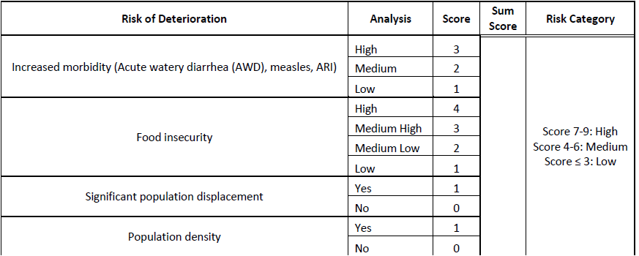
Targeted Supplementary Feeding Programme
Risk of deterioration Assessment
Programme Recommendation
Source: Moderate Acute Malnutrition: A decision tool for emergencies (GNC, 2017)

Slide 18
Supplementary Feeding Programme
Blanket Supplementary Feeding Programme:
  ⬆ MAM
  ⬆ Food Insecurity
  ⬆ Prevalence of Chronic malnutrition
Targeted Supplementary Feeding Programme:
  Part of the emergency nutrition response
  Duration 1 – 4 months:
    GAM
    Aggravating factors or
    Numbers of beneficiaries
In absence of SFP or inadequate supply of RUSF
  Expanded criteria in ATFC to include MAM
  MUAC < 115 mm 2 sachets of RUTF
  MUAC 115-125 mm 1 sachet of RUTF
Source: Moderate Acute Malnutrition: A decision tool for emergencies (GNC, 2017)

Slide 19
Simplified Approaches

Slide 20
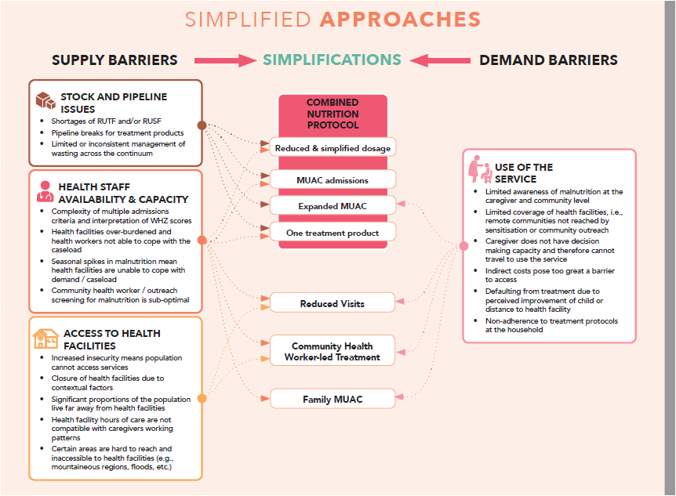
Simplified Approaches
Simplified approaches refers to several modifications and simplifications to the existing national and global protocols for the treatment of acute malnutrition:
Family MUAC
CHW-led treatment of acute malnutrition (wasting)
Reduced Frequency of Follow-up Visits
MUAC & oedema only: Admission, treatment & discharge
Expanded admissions criteria
Use of a single treatment product
Optimized Dosage
The simplifications 4 to 7 are often used conjointly as the combined nutrition protocol
Notes:
Family MUAC: Engaging family members to screen and refer their children
CHW-led treatment of wasting: Management of wasting by Community Health Workers (CHWs)
Reduced Frequency of Follow-up Visits
MUAC and oedema only: Admission, treatment, discharge based on Mid-upper arm circumference (MUAC) and/or oedema
Expanded admissions criteria: Systematic expansions of MUAC to include more children (e.g., 120mm or 125mm)
Use of a single treatment product: Use of ready-to-use food (RUF) for the treatment of all wasted children in need of treatment
Optimized Dosage: Treatment dosage of RUTF product modified over course of recovery

Slide 21
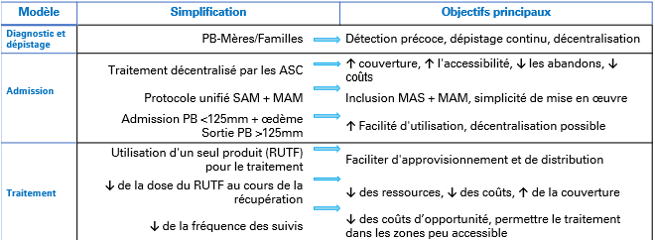
Simplified Approaches – West Africa
Source: SIMPLIFIED APPROACHES: Where are we now? West and Central Africa Regional Office, UNICEF Jan 2020

Slide 22
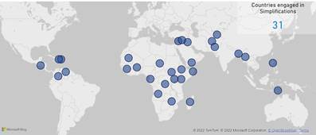
Simplified Approaches - World
Senegal
Burkina Faso
Sudan
Nigeria
Afghanistan
Ethiopia
Somalia
South Sudan
Other countries in WCA case by case
Source: West and Central Africa Regional Office, UNICEF July 2022

Slide 23
Simplified Approaches - OCBA

Slide 24
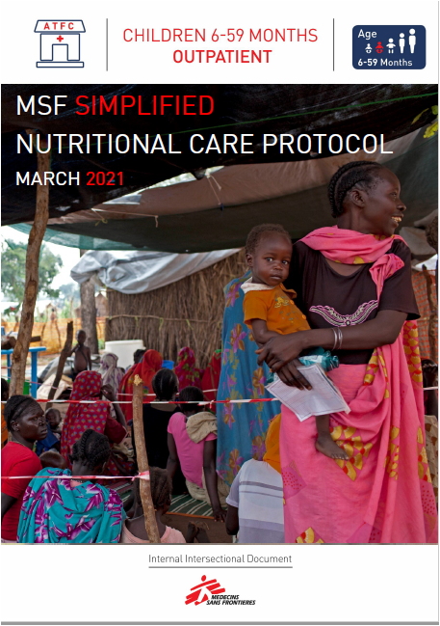
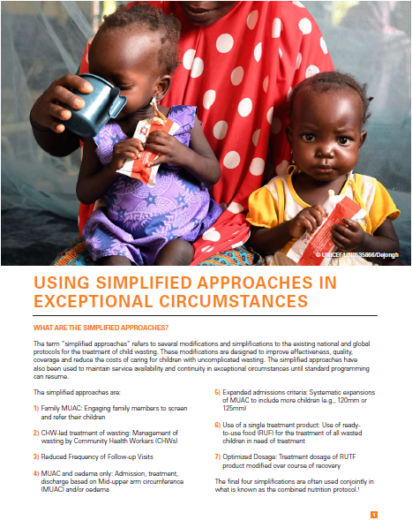
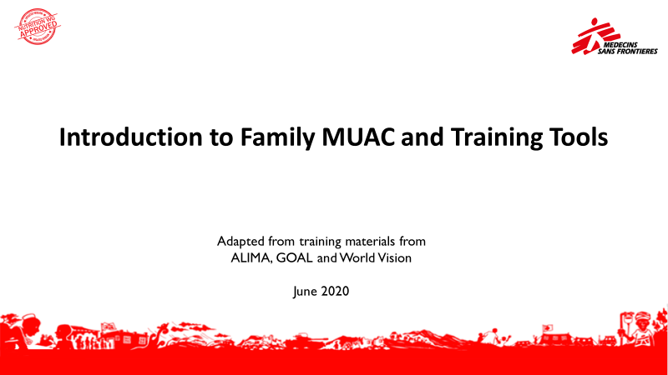
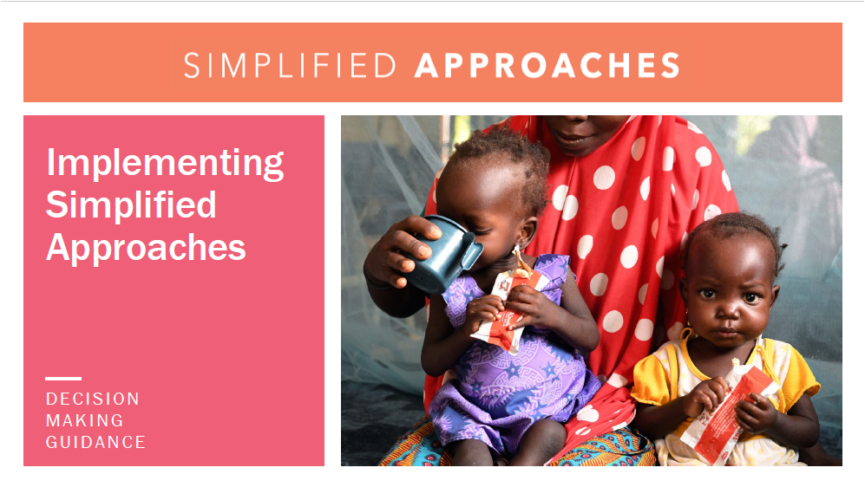
Simplified Approaches - Documents
MSF Intersectional Protocol
UNICEF Decision Making Guidance
MSF-OCBA Family MUAC Material
UNICEF Decision Making Presentation

Slide 25
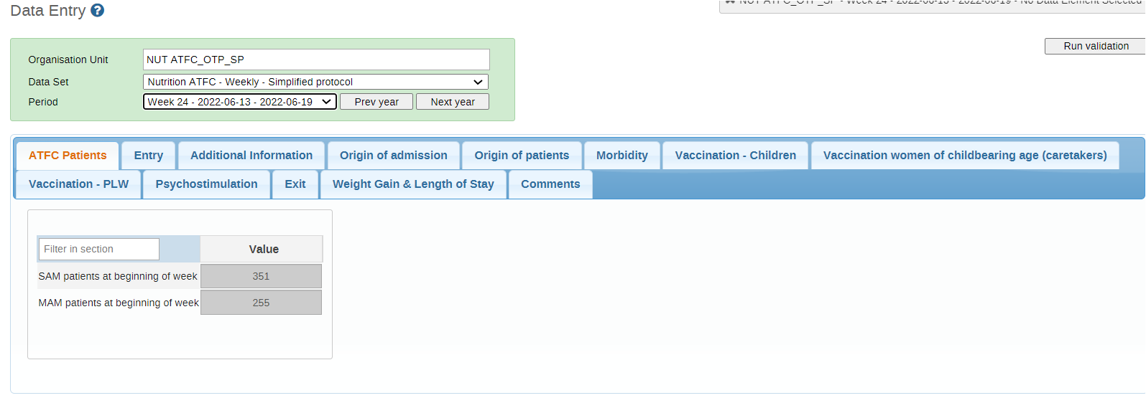
Simplified Approaches – HMIS 1/2
Name_SP
Distinguish MAM from SAM
Notes:
Name: ATFC _ Simplified Protocol
Distinguish MAM from SAM in patients at the beginning of the week between

Slide 26
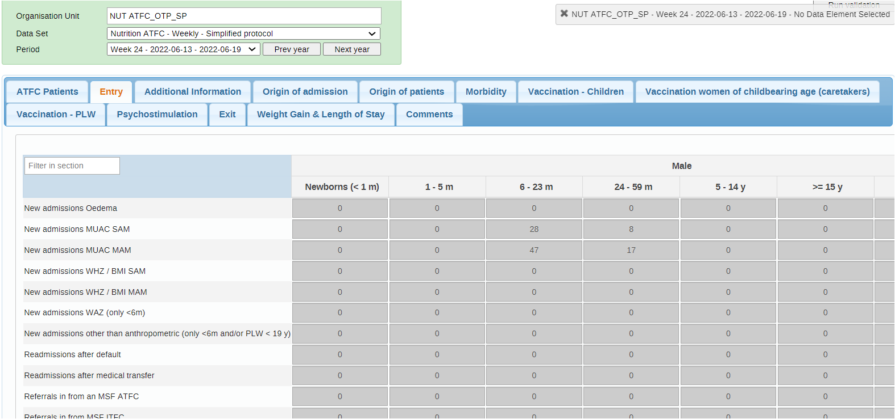
Simplified Approaches – HMIS 2/2
Entry Sheet
Distinguish MAM from SAM
Distinguish MUAC from WHZ
Notes:
Entry Sheet: Main changes are there.
Distinguish from MAM to SAM in New Admissions and by admissions criteria.
This information is important for decision making.

Slide 27
Specialised Nutrition Food

Slide 28
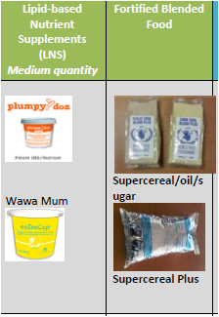
Preventive purpose – Acute Malnutrition
General Food Distribution
Targeted Food Distribution
Blanket Supplementary Feeding

Slide 29
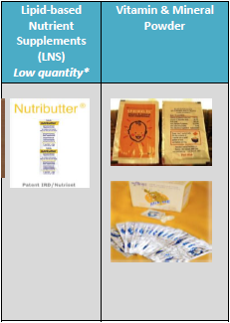
Preventive purpose – Chronic Malnutrition
Micronutrient Deficiencies
General Food Distribution
Targeted Food Distribution
Blanket Supplementary Feeding

Slide 30
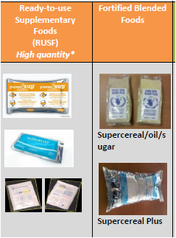
MAM Management
Targeted Supplementary Feeding
Blanket Supplementary Feeding

Slide 31
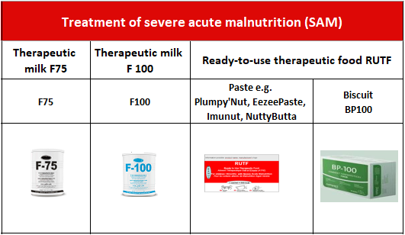
SAM Management
Therapeutic Feeding programme:
  ITFC
  ATFC

Slide 32
Final comments

Slide 33

Phasing Out Nutritional Interventions
Depend on the nutritional and medical situation, social and political environment, and foreseeable trends in food security issues
Phasing out criteria should not be used as a strict set of rules
Nutrition survey to help in the evaluation of the situation and the decision making.
Hand over to the ministry of health or other NGOs
The number of patients in a therapeutic feeding programme falls to a number which is manageable by the basic health care programmes and paediatric wards.
Ensure that no influx of people is expected
Ensure that no emergency outbreak is expected

Slide 34

Key messages
Each situation requires its own coherent strategy for this reason interventions should be constantly adapted.
Nutrition is a cross-cutting issue : any MSF intervention must ask if the nutritional requirements of the patients/beneficiaries are covered. Otherwise, what can we do to improve it?
Programs and strategies are constantly in evolution for this reason, ask for advice to the referents is a good practice 😉

Slide 35
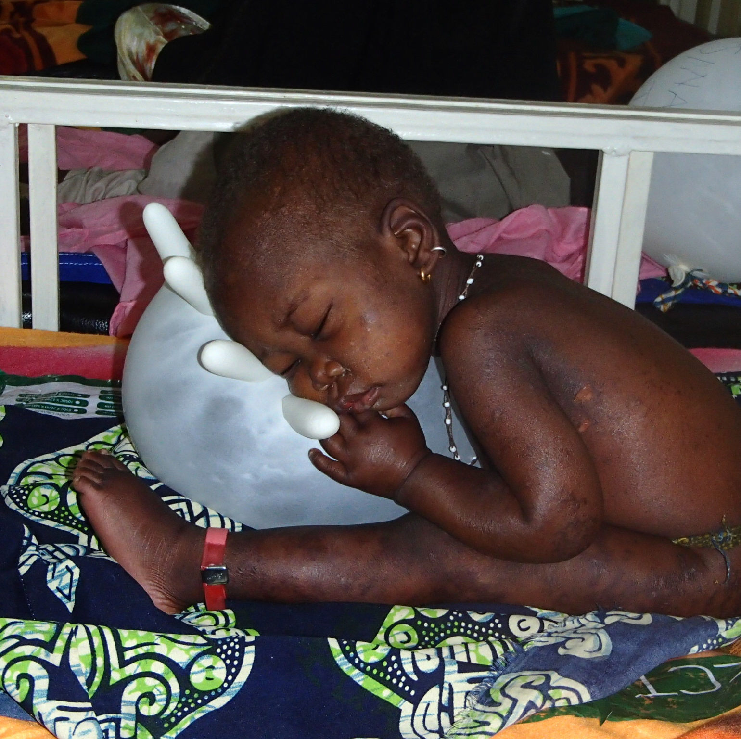

Thank you

