Slide 1
M10 IPC
S35 IPC FOR THERAPEUTIC MILK PREPARATION, DISTRIBUTION AND STORAGE

Slide 2
OBJECTIVES OF THE SESSION
At the end of this session participants will be able to:
Recognize the IPC for therapeutic milk preparation, distribution and storage.
Notes:
The facilitator states the objectives of the session.

Slide 3
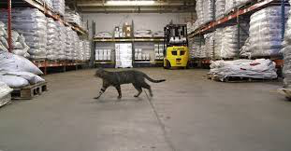
question 1: Can you identify the bad practice in this picture?
Notes:
Do not give the correct answer during activity
Give the answer at the end of activity 2:
The use of cats in the warehouse is forbidden. They are relatively useless and cause hygiene problems.

Slide 4
question 2: Are these milk boxes are correctly stored? Why/why not?
Notes:
Do not give the correct answer during activity. Give the answer at the end of activity 2:
They seem correctly stored. However, we do not have all the information.
Aspects correctly seen in the picture:
- Stored separate from logistic items.
- Stored on pallets. Only one product, all from the same batch (bearing the same batch number).
- There are corridors between the rows of pallets.
- Clearly label the pallets with the batch number and the expiry date (to be done upon receipt of product). In the picture we can read the number 42 in red.
Not clearly seen in the picture:
- We cannot see the distance from the products to the Wall (30 cm?).
- Products should be stored according to item category, expiry dates, outgoing frequencies, and weight/volume.
- Temperature is not known.

