Slide 1

M6 CASE MANAGEMENT IN INFANTS 1-6 MONTHS
S22. MATERNAL SUPPORT

Slide 2
OBJECTIVES OF THE SESSION
  At the end of this session participants will be able to:
  To be aware of the type of counselling and support needed by all mothers that have an infant admitted in a nutrition programme.
Notes:
The facilitator states the objectives of the session

Slide 3
QUESTION
    What do you think of the breast attachment of this infant? Explain your answer.

Slide 4
ANSWER:
Poor attachment
Good attachment

Slide 5
nutritionAL screening OF MOTHERS/CARETAKERS
All mothers of infants 1-6m should be screened with MUAC:
If MUAC < 230 mm
Treatment for malnutrition
Nutritional Status | MUAC
No malnutrition | ≥ 230 mm
Acute malnutrition – needs admission into nutrition programme | < 230 mm
Notes:
Mother support covers all mothers: the breasfeeding and the non-breasfeeding mothers
A nutrition screening with MUAC will be done to all mothers:
If the mother has a MUAC < 230 mm, a malnutrition treatment should be started.

Slide 6
Standard medical protocol for LACTATING WOMEN
(not malnourished)
Treatment | Dosage
Multiple Micro-nutrient (MMN) tablets PO or Iron/Folic Acid | 1 tablet daily until the infant has reached 6 months of age
Calcium PO | 1g daily for all adolescent LW (<19y) until the infant has reached 6 months of age
Tetanus Vaccination | According to national protocol
If mild or moderate anaemia (haemoglobin < 11 or 10 mg/dl respectively), : 1 MMN tablet and 1 or 2 Ferfol / day.
Notes:
A systematic treatment is given to all lactating woman (LW).
In case of mild or moderate anaemia (haemoglobin < 11 or 10 mg/dl respectively), treat LW for iron deficiency anaemia with a therapeutic dose of iron: 1 MMNs and 1 or 2 Ferfol / day.

Slide 7
maternal counselling and support
  Balanced meals (breastfed mothers extra 400-500 kcal/day – extra local food or RUSF)
  At least 3 litres of water / day.
  Adolescent mothers need adapted care
  Rest
  Put infant on the breast at least 20 min to one hour before the milk feeding
Notes:
Provide balanced meals with minimum requirements (the breasefed mothers will receive extra kcal)
Encourage the mother to drink at least 2 litres of water / day and more if the weather is hot.
Adolescent mothers need extra care, more food and more rest than an older mother (need to nourish their own bodies, which are still growing, as well as their growing infant’s)
Encourage rest
Encourage the lactating mother to put always the infant to the breast at least 20 minutes about one hour before the milk feeding
Encourage all mothers to use kangaroo mother care method to prevent hypothermia

Slide 8
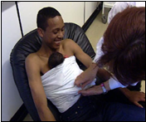
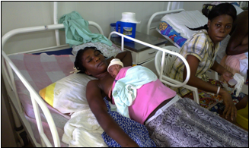
maternal counselling and support
  Kangaroo mother care method to prevent hypothermia
Notes:
Kangaroo Care (KC) means to promote and perform continuous close skin-to-skin contact between the caretaker and her baby. KC should ideally be practiced 24 hours daily with special attention given to the caretaker when she is sleeping.
Objectives of kangaroo care
Keeps the infant warm while preventing or treating hypothermia. Better physiological stability.
Helps to establish breastfeeding and decreases episodes of gastro-oesophageal reflux.
Encourages mother-infant bonding.
Reduces stress and pain for the infant.
Decreases episodes of apnoea and bradycardia in infants.
Decreases nosocomial infections.
Reinforce affective attachment of the mother to her baby.
Improve weight gain and neurological development.
Allow the mother to continue daily activities while caring for her infant (after discharge and so outside the ITFC).
KMC should be done as often as possible for babies < 2500g. It should be attempted as often as possible as long as the baby can tolerate it (i.e. baby is maintaining stable vital signs with no new danger signs while in KMC position) even in intensive care settings
Kangaroo care in practice
The young infant is placed against the belly of the mother / wet nurse, with direct skin contact.
Place the baby in such a way that the breast is always within reach of the young infant’s mouth.
Use a cloth to secure the baby and wrap the pair with a cover wrapped around the mother / wet nurse.
Settle them into the warm room in ITFP.
Hold the baby vertically against the chest, maintaining skin-to-skin contact. Ensure the child is well covered, including head to prevent heat loss.
KC can be provided equally by both, mother and father to prevent hypothermia of the infant.
KC while breastfeeding and sleeping (mother ideally elevated at 30 degrees from the horizontal plan).

Slide 9
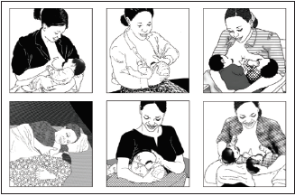
Attachment-POSITIONING
Optional video:
https://globalhealthmedia.org/portfolio-items/attaching-your-baby-at-the-breast/?portfolioID=5623
Notes:
Attachment
1. Infant’s mouth wide open
2. Lower lip turned outwards
3. Chin touching breast
4. More darker skin (areola) visible above than below the mouth
Positioning
1. Infant’s body should be straight, not bent or twisted
2. Infant’s body should be facing the breast
3. Infant should be held close to mother
4. Mother should support the infant’s whole body, not just neck and shoulders (for tummy down or reclining position: assisted by gravity, with baby’s full weight resting on mother’s body during the period the infant is learning to breastfeed; works with cesarean sections)

Slide 10
maternal CONCERNS
  Mother thinks she does not have enough milk
  Mother thinks she is unable to breastfeed, lacking confidence in her abilities
  Mother thinks that her diet affects her ability to produce milk
  LISTEN! Give personalised advice, each mother is different!
Notes:
Mother thinks she has “not enough” breastmilk production
Listen to mother’s concerns and why she thinks she does not have enough milk
Check infant’s weight and urine and stool output (if poor weight gain, refer)
Look for good attachment
Look for effective suckling
Ask about frequency of breastfeeds: 8 – 12 times in 24 hours
Stop any supplements: infant should receive no water, other drinks or foods
Look for illness or physical abnormality in the infant or mother
Look for bonding or rejection
Build mother’s confidence – reassure her that she can produce enough milk
Explain what the difficulty may be
Explain: ‘The more an infant suckles and removes milk from the breast, the more milk the mother produces’
Let infant come off the first breast by him/herself before mother offers the 2nd breast
Avoid separation, and keep mother and infant skin-to-skin as much as possible
Ensure mother gets enough to eat and drink
Mothers of twins produce enough milk to feed both infants if the infants breastfeed frequently and are well attached
The more an infant suckles and removes milk from the breast, the more milk the mother produces
Mother thinks she may be unable to breastfeed the infant
Listen to mother’s concerns.
Assess mother for any problem she thinks she may have; if appropriate, help mother addres the issue
Encourage her to enjoy skin-to-skin contact and to play with her infant face-to-face
Build her confidence:
Recognize and praise what she is doing right – including signs of milk flow
Give relevant information in an encouraging way and correct misconceptions
Provide mother with hands-on help to attach infant to breast and get breastfeedin established
Help her to breastfeed near trusted companions, which helps relaxation
Mother thinks her diet affects her ability to produce enough good quality breastmilk
Listen to mother’s concerns about her diet and her ability to breastfeed
Remind mother that breastmilk production is not affected by her diet:
No one special food or diet is required to provide adequate quantity or quality of breastmilk
No foods are forbidden
Mother should limit alcohol and avoid smoking
Encourage mother to eat more food to maintain her own health:
Eat two extra small meals or ‘snacks’ each day
Continue eating a variety of foods
Use iodized salt
‘Drink to satisfy thirst’
Consume local dietary sources of vitamin A
Attend nutrition education (family, child; cooking demonstrations)

Slide 11
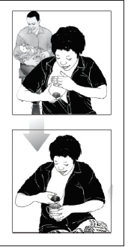
BREASTMILK EXPRESSION
  Optional video: https://globalhealthmedia.org/portfolio-items/how-to-express-breastmilk/?portfolioID=5623, 7:30 min
Notes:
Ask the mother to:
Wash her hands thoroughly ==> Hygiene is very important to avoid contamination!
Make herself comfortable
Hold a wide necked clean container under her nipple and areola
Stimulate breast with light stroking or gentle circular motion around whole breast
Place her thumb on top of her breast and the first 2 fingers on the underside of her breast so that they are opposite each other
With thumb and fingers press back to chest wall, press and hold together (compress) and release
Repeat the action: press back to chest wall, press and hold together and release. Note: this should not hurt
Compress and release all the way around the breast, with thumb and fingers the same distance from the nipple. Be careful not to squeeze the nipple or to rub the skin or move thumb or finger on the skin
Express one breast until the flow of milk is very slow; express the other breast
Alternate between breasts 5 or 6 times, for at least 20 to 30 minutes

Slide 12
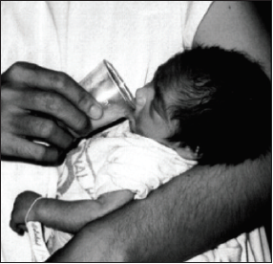
CUP FEEDING
  Optional video: https://globalhealthmedia.org/portfolio-items/cup-feeding/?portfolioID=13325, 8:56 min
Notes:
Assess readiness for cup feeding: rest the cup against the infant's lips, with milk touching infant's top lip. Wait and watch for infant response. If no response, try at next feed. If no response after 2-3 trials, then refer to a facility where infant can be 'supported' to suckle.
Ask the mother or caregiver to:
Put a cloth on the infant's front to protect his/her clothes as some milk can spill
Hold the infant upright or semi-upright on the lap
Put a measured amount of milk in the cup or pour only amount to be used at one feeding into the cup
Hold the cup resting on the lower lip and tip the cup so that the milk touches the infant’s upper lip
Wait for the infant to draw in or suckle in the milk
Allow the infant to take the milk himself. DO NOT pour the milk into the infant's mouth
Caregiver should pause and let infant rest after every few suckles
Caregiver should pay attention to infant, look into infant’s eyes and be responsive to infant’s cues for feeding
Do not reuse any milk the infant does not drink for another feeding

Slide 13
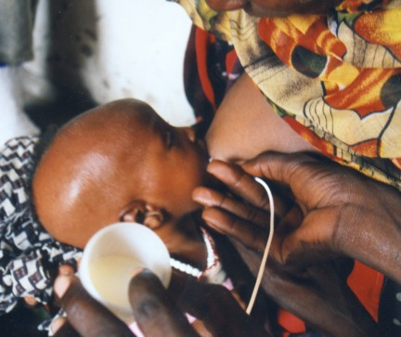
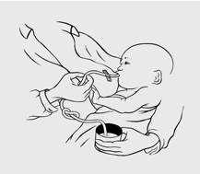
Supplemental Suckling Technique using a NGT
Notes:
This technique is used to stimulate the production of breast milk (double suction method).
One end of a soft, small-calibre stomach tube (CH 5 or 6, max. 8) is fixed on the mother’s breast with a piece of tape in a manner such the tip reaches the nipple.
The other end is placed in a cup of milk (breast milk or appropriate alternative like BMS or SDTM).
When the child nurses, s/he drinks the milk from the cup while simultaneously stimulating the nipple.
Initiate each feeding session on alternate breasts to avoid excessive nursing/nipple cracking on one side.
Adjust the speed of milk intake by raising or lowering the cup or by pinching the feeding tube.
Any milk left in the cup after the infant stops nursing should be fed via cup or syringe.
Feeding bottles must be avoided due to high risk of infection.
To prevent contamination or blockage, rinse the tube in warm water after each feeding and put it away, clean, in its wrapper. Replace the tube once a day.
Naso-gastric tube; may be necessary initially only if infant is not able to suckle at all. In this case encourage mother to express breast milk and feed through the naso-gastric tube completing the required volume with BMS or SDTM.

