Slide 1
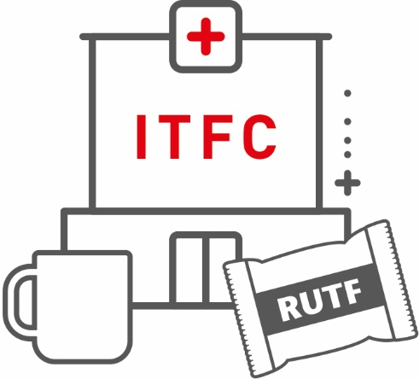
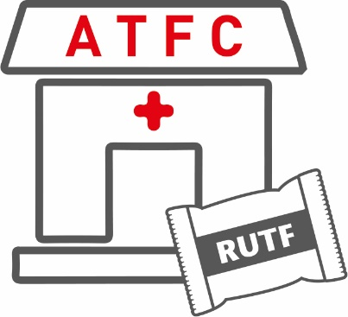
M4 CASE MANAGEMENT
S11 NUTRITIONAL Treatment phases

Slide 2
OBJECTIVES OF THE SESSION
At the end of this session participants will be able to:
Understand the different phases of nutritional treatment in a nutrition programme
Understand the objective and specifics of each of the phases.
Understand the criteria for moving between phases.

Slide 3
INTRODUCTORY CASE
ANNIKA:
3-years-old. Ward round. ITFC. 3rd day in Transition Phase. Marasmus
She is in the Transition Phase taking RUTF paste-based very well.
She has repeatedly requested more quantities of food. No medical symptoms.
Examination: Alert. Respiratory Rate: 28 rpm. Heart Rate: 95 bpm. O₂ Sat.: 100%. No fever. No respiratory distress. Normal pulse, warm hands and feet. Capillary Refill 1 second. 4 cm enlarged spleen. Rest of examination is normal.
QUESTION:
COULD ANNIKA BE CHANGED FROM TRANSITION TO PHASE 2 (ATFC)?
Notes:
3
3
3

Slide 4
Age
SUMMARY TABLE OF
6 – 59 Months
NUTRITIONAL TREATMENT for Children 6-59 months
Objective
NUTRITIONAL TREATMENT
Duration
Restore metabolic function
Stabilise clinical condition
Begin resolution of oedema
F-75 - QUANTITY
135ml/kg/day
8 meals/day
100kcal/kg/day maximum
I
PHASE 1: STABILISATION
T
Usually
1-7 days
F
- Inpatient -
C
Ensure return of appetite and acceptability of RUFT
Ensure ongoing clinical improvement
Continued improvement of oedema
OPTION A: RUTF-Based
I
TRANSITION
PHASE
T
or
OPTION B: F-100 Based
F
QUANTITY
6 or 8 meals/day
135kcal/kg/day
C
- inpatient -
Usually
1-3 days
ATFC
Promote weight gain and return to regular development
Recovery
RUTF
PHASE 2
REHABILISATION
QUANTITY
prescribed by weight
200kcal/kg/day
Family meals if still hungry after RUTF consumed
+
- outpatient -
30-35 days
(after ITFC)
- Rarely ITFC -
Notes:
Nutritional treatment in a nutrition programme is composed of 3 phases: Phase 1, Transition phase and Phase 2. For children under 6 months another specific stage is followed.
Phase 1 and Transition phase are delivered in ITFC and Phase 2 in ATFC (except for rare cases where a child needs to start Phase 2 as an inpatient).
Each phase has a specific objective, specific nutrition products used, and specific activities that must accompany it (e.g. vaccination. The length of stay in each phase will vary according to the child’s condition and clinical evolution.
An ITFC should be organised so that it is very clear which patient is on which phase. This could be through different areas of the ward being assigned to each phase or if this is not feasible then each bed has a label on to show which phase the child is in.
In each ITFC, the decision to change children from one phase to another should be made by the clinical team including the staff member who does the daily ward round (usually a doctor) in conjunction with the nutrition assistants and nurses who have first-hand knowledge of how the child has been feeding and any other issues the child/caretaker has that are not discovered in the ward round.
The criteria to change phase must be strictly followed. Make sure patients are not changed from one phase to another too quickly (or take too long to change).
→Criteria for changing from phase 1 to the transition phase
Medical complications have been stabilised
Appetite has begun to return, and
Oedema has reduced (can go to Transition phase if ++ oedema, but meeting the other above criteria).
→Criteria to change from the transition phase to phase 2 (ATFC)
Good appetite: the child easily finishes his RUTF and asks for more (quantities should not be increased in the transition phase). If the regimen chosen was the F100, the child needs one day with RUTF to evaluate the acceptance
Medical complications are stabilised.
Oedema has reduced (can go to Phase 2 if + oedema but meeting the other above criteria).
Note: Patients in Transition Phase may require transfer back to Phase 1 if complications arise.
→Criteria for transfer back to Phase 1: When one of the following signs develops:
Development of significant re-nutrition diarrhoea (white stools 15-30 minutes after eating) with weight loss. We often see a change in stool consistency and colour when children move phases, but if this is only mild and there is no weight loss then they can still stay in transition phase.
Re-appearance of œdema.
Any signs of fluid overload and/or heart failure
Diarrhoea with severe dehydration
Phase 2: ATFC: Most children who are directly admitted into an ATFC (not referred from an ITFC) are admitted into Phase 2 (without doing phase 1 and transition phase, which are inpatient). There are specific situations that phase may be delivered in ITFC:
→ Children that are transferred from ATFC to ITFC for investigation due to lack of response to treatment with a preserved or normal appetite and who are clinically stable (an unwell child who is seen in ATFC and is thought to be septic, for example, is likely to need to re/start in Phase 1)
→ Also, children with MAM and medical complications with a preserved or normal appetite and who are clinically stable (an unwell child who is seen in ATFC and is thought to be septic, for example, is likely to need to re/start in Phase 1)
Note: It is common for the children to get some change in stool frequency when they change diet. This does not need to be treated unless the children lose weight. Several loose stools without weight loss are not a criterion to move back to acute-phase.

Slide 5
INTRODUCTORY CASE
ANNIKA:
3-years-old. Ward round. ITFC. 3rd day in Transition Phase. Marasmus
She is in the Transition Phase taking RUTF paste-based very well.
She has repeatedly requested more quantities of food. No medical symptoms.
Examination: Alert. Respiratory Rate: 28 rpm. Heart Rate: 95 bpm. O₂ Sat.: 100%. No fever. No respiratory distress. Normal pulse, warm hands and feet. Capillary Refill 1 second. 4 cm enlarged spleen. Rest of examination is normal.
QUESTION:
COULD ANNIKA BE CHANGED FROM TRANSITION TO PHASE 2 (ATFC)?
Yes, she can go from ITFC to ATFC. Because she has appetite, eats the RUTF well and does not have any medical complications which require her to be in hospital
Notes:
5
5
5

