Slide 1
M2 PATIENT FLOW FOR CLINICAL DECISION MAKING
S6 FLOW OF PATIENTS

Slide 2
OBJECTIVES OF THE SESSION
At the end of this session participants will be able to:
Describe the steps a patient flow must follow, from arrival until they are admitted (or not) into a nutrition programme.
Describe how sugar water is prepared

Slide 3
questionS
Describe the correct patient flow from arrival until they are admitted (or not) in a nutrition programme (ATFC or ITFC)?
What activities should be included at each step?
If the flow of patients is not completed and/or is not correctly organized, what might happen? What are the potential consequences?
Notes:
Brainstorming in plenary

Slide 5
TRIAGE
Check for emergency signs
Regularly re-evaluate children in the waiting area.
Avoid having children waiting too long.
Ensure HCW in triage is properly trained and supervised.
Check MUAC and Oedema
Notes:
Waiting area- Triage (how this is done may vary from project to project, e.g. some may use Emergency Treatment Assessment Triage (ETAT), other the South African Triage System (SATS) or one from the MoH):
Some of the below will vary according to whether it is a vertical nutrition project (i.e. only nutrition activities) or if the nutrition programme is integrated into a health centre or hospital/inpatient facility as one of many services provided
Triage is the first activity which must be performed on a patient’s arrival to the health facility (normally in the waiting area). This allows staff to rapidly organize the waiting area and identify life threatening conditions (emergency signs) in patients that must be treated immediately (priority 1-red card), those with serious conditions that should be treated rapidly (priority 2-yellow card) and those who should be treated in turn (priority 3-green card).
In most contexts prone to malnutrition, MUAC and oedema are compulsory as part of the triage.
On arrival, the patients are directed to the triage area where they will be assessed for the presence of emergency signs and if there are none needing immediate medical action (red), then they will carry out the nutritional screening. The criteria used for this screening will depend on the age of the patient and the projects’s strategy (e.g. some projects may only use MUAC and oedema). These measures and criteria include: oedema, MUAC, WHZ, WAZ or other nutritional complications (a criteria most often used for the 1-6 month age group).
Patients found to have no acute malnutrition or nutritional complications will not be referred to the nutrition programme (ITFC or ATFC). Emergency/priority signs will be evaluated, and the patient will be referred to the OPD/PHC or paediatric IPD according to his/her condition.
If the patient is an infant 1-6 months they will either be admitted directly to the ITFC or to the ATFC if the project is set up to treat these infants on an outpatient basis.
Three points to consider for any triage system:
Regularly revaluate the child in the waiting area to quickly identify sick or weak children who need medical assistance – clinical condition can change/deteriorate quickly in children.
The triage system must be efficient to avoid children having to wait too long to receive medical attention.
The person in charge of the triage should be someone properly trained who feels confident managing this busy and important service.
For a waiting area of an ATFC, the triage procedure is the same.
It is important if the child needs referral to the ITFC:
To organise the referral as soon as possible
The patient should be kept in the observation room waiting for the referral (do not let them wander outside in case their condition deteriorates)
The caretakers must be informed of the importance of the referral to the ITFC and that it is likely that their child will need to be hospitalised for several days. Having a staff such as a health promoter assigned to this activity can be very useful.
Note:
If a patient has been referred directly to the Emergency Department of a hospital, before the MUAC and oedema was taken, then, the measurements will be taken there to determine if the patient is SAM or MAM. If so, the patient should be managed according to the nutrition and medical protocols for complicated acute malnutrition and be quickly referred to the ITFC ward (or ICU ITFC).
This training does not have the objective to explain the triage (ETAT) activity in detail.

Slide 6
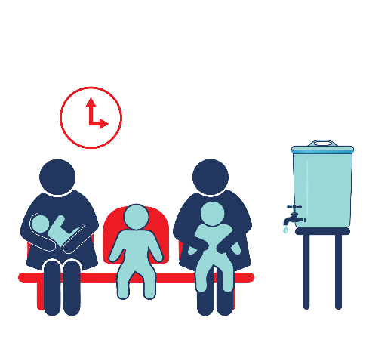
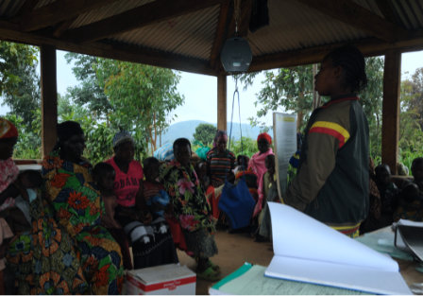
Waiting area - health promotion
Notes:
Waiting area- Health promotion
While patients and caretakers are waiting for the medical consultation, basic health messages can be communicated, including information on what patients can expect from the nutrition programme – this should also be a time that caretakers can ask questions
All efforts should be made to make the caretakers feel welcome and minimise the stress they are experiencing secondary to having a sick child and being in this environment.
The messages to be given are explained in Module 8
Waiting area- General aspects to consider:
Minimum well-being conditions for children and caretakers should be ensured at the reception and in the waiting room
Should have a shadow net to protect patients and their carers from sun and some form of shelter to protect them from rain.
The maximum waiting time should be 2 hours for green cases
It should be divided in different areas:
Area with benches to sit down for the new arrivals and a separate area for the patients that are in the programme and are coming for follow-up
Area with benches for the patients classified as P2: orange
Areas with benches for the patients classified as P1: green
Water point with cups for drinking and sugar water freely available. Also, area at water point to wash hands with soap always present.
Area of the person doing triage should have a table and basic triage equipment (see resources on setting up a triage and triage kits)
Privacy should try to be maintained for patients in triage. If there is only one person doing triage there has to be a balance of privacy (e.g. using a screen/small wall) versus being able to see all the patients and keep an eye if anyone deteriorates. Ideally triage should be done by more than one person.
A latrine should be close to the waiting area and set up for adults AND children

Slide 7
SUGAR WATER 10%
Quantity of Water | Quantity of Sugar
100 ml | 10g (2 tea teaspoons)
Notes:
Waiting area- Sugar water
Sugar water should be available and encouraged for every SAM child in the waiting area
To prevent hypoglycaemia: Often a SAM child will not have been fed for several hours before arriving at the health facility and there may be a period of time before the admission procedures are finished and the first milk feed (in ITFC) or RUTF (in ATFC) is offered.
Give 50ml to children < 10kg, 100ml to children between 10 and 20kg and 200ml if > 20kg. If weight is unknown, children can be sent to the anthropometric measurement area to measure the weight, but usually estimations of weight and amounts are sufficient, and a child can always be given more if they ask for it.
However, note that feeding should start as soon as possible upon admission to the ITFC – this is facilitated by the F-75 and F-100 now being in tins as individual cups can be prepared from the scoops even if it is in between meal times
Sugar water is only given to children that can drink and do not have respiratory distress as this can increase risk of gastric aspiration. Otherwise children will need IV dextrose.
The sugar water 10% is prepared with the following proportion of water and sugar: 100 ml of drinking water + 10 g of sugar (1 tea spoon = 5g); 1 litre of water + 100 g of sugar
Table 1: Preparation of sugar water (10% dilution)
Quantity of Water
Quantity of Sugar
100 ml
10g
(2 teaspoons)

Slide 8
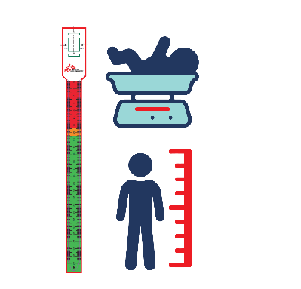
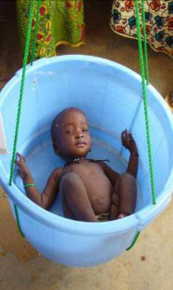
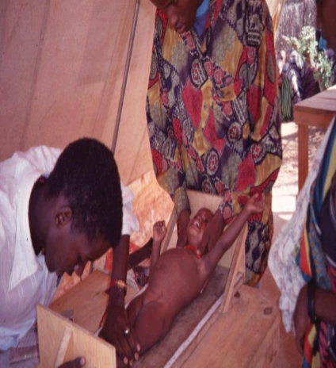
CHECK WEIGHT AND HEIGHT
Notes:
Weight and height measurements
For the patients with medical complications, the weight and height will be done when possible, knowing that the priority is to first stabilise the patient.
For the patients without medical complications, the weight and height measurements will be done before the appetite test (this is based on weight).
In some settings weight and height is done after the triage of the emergency signs while children are waiting in the waiting area
As the measurements are taken before knowing if the patients will be admitted into the ITFC or the ATFC, the measurements are not yet registered in the nutrition programme register book (they are written down on a separate paper/notebook). They may however be recorded in the emergency department/admission unit register.

Slide 9
CHECK FOR MEDICAL COMPLICATIONS
Notes:
Checking for medical complications
Remember that to correctly assess if the child needs to be admitted into ATFC or ITFC, checking for medical complications should be done after the anthropometric measurements (minimum MUAC and oedema). Medical complications needing admission into ITFC include:
Shock
Severe anaemia (<4g/dl or 4-6g/dl with signs of decompensation)
Seizures
Persistent hypoglycaemia
Pneumonia with or without signs of severity
Malaria with signs of severity
Other severe infections (meningitis, septicaemia, skin/soft tissue)
Diarrhoea with severe dehydration or dysentery
Lethargy, not alert, unconscious
Intractable vomiting
Other condition needing further investigation or treatment (TB, HIV, fever of unknown origin)
Severe skin infection/lesions (including severe kwashiorkor skin lesions)
Vitamin A deficiency-related eye conditions
Congenital malformations leading to feeding difficulties
Patients found to have MAM or SAM must be quickly clinically examined by a nurse or doctor to evaluate if they have medical complications.
If the patient has oedema +++ and/or medical complications, they will be referred and admitted directly into the ITFC for immediate stabilization and to start treatment.
If the patient does not have medical complications and only + or ++ oedema, the appetite test will be done to take the decision of whether to treat the child in ITFC or ATFC. The MAM patients without complications will be referred to a Targeted Supplementary Feeding Programme (TSFP) if available in the area. Some projects may decide to treat the MAM patients in ATFC

Slide 10
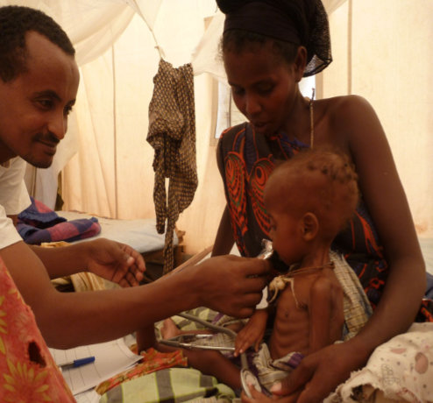
APPETITE TEST
Notes:
Appetite test
Remember that Appetite test is another essential criterion for deciding if a patient has complicated or uncomplicated SAM or MAM and if they will be admitted into the ITFC or ATFC. If the child has poor/no appetite (anorexia) and fails the appetite test, s/he should be referred for inpatient treatment (ITFC) even in absence of other complications. If the child vomits after eating the RUTF (but was willing to eat it), they can be kept in the observation area and you can try the appetite test again a bit later. If they vomit again, they will need to be referred to the ITFC for assessment and likely admission.
If the patient does not have medical complications, the appetite test will be done to make the decision about whether the patient is treated in ITFC or ATFC.
In some settings, it will be done in a corner of the waiting area (with RUTF and water available) and in other settings a specific room will be allocated. The ideal situation is to have a separate quiet area with water for drinking available and staff present to support the caretakers, but this may not always be possible in every project depending on the space and HR available

Slide 11
registration
Notes:
Registration
The patient will be only registered once it is known to which service they will be admitted into (ATFC or ITFC). This is to avoid registering a patient twice having a double registering (in the ATFC and in the ITFC). The patient may be entered into the emergency department/admission unit register so that they can keep track and monitor their activities.
Therefore, the register is usually located in a separated room but in some settings with limited space, the registration might be set up in the waiting room (next to the anthropometric measurements).
For referrals from one centre to the another or cases not being admitted yet, a list of referrals will be done for double checking.

Slide 12
Bad practice | Consequences
Staff in ED or admission unit not trained to understand the basics of malnutrition and why malnourished children are different to non-malnourished patients, plus the differences in stabilisation protocols for malnourished and non-malnourished patients. | Mismanagement of malnourished children. Some diagnoses of medical complications and their management in SAM and MAM patients are different than for a non-malnourished patient. For example, severe dehydration, shock, pain management etc, and if not well diagnosed or managed can cause fluid overload, heart failure and other serious consequences, including death.
New patients that arrive at the ATFC and need referral at the ITFC, are first admitted and registered into the ATFC | The same patient will be newly admitted twice in both centres. This will create a bias in the statistics and could lead to a false number of admissions being recorded in the ATFC. The patient can be registered in the ED register to show their workload and for other monitoring indicators. They should be registered in the ITFC as a new admission and source can be the ATFC.
Not having sugar water available in the triage and waiting area | Risk of hypoglycaemia – patients have often not eaten for a while, perhaps have had a long journey and long waiting times can all lead to hypoglycaemia
Waiting time too long (e.g. 5 hours) | Patients and caretakers feel tired and disappointed with the service and may even leave before they are seen. In addition, even if they wait to be seen, they may refuse to come back for another appointment if they think they will have to wait for a similar amount of time. Caretakers often have many work and household duties and time is precious. Especially if they have travelled a long way to the clinic
No shadow net in the waiting area | Patients feel too hot, risk of sunstroke, they may leave before being seen and might not want to come back for a future appointment if they think they will again be waiting in the sun for a long time.
Not carrying out regular re-evaluations of patients in the waiting area | Patients clinically deteriorating in the waiting are. A non-urgent case can become an emergency case.

Slide 13
Wrap up

