Slide 1
Fatima
Girl 13 months
MUAC: 122 mm
Weight: 8.1 kg
Length: 74.4 cm
Oedema: ++
Notes:
WHZ: > -2
MUAC: MAM
But the child has SAM because of the oedema
CATEGORY: SAM

Slide 2
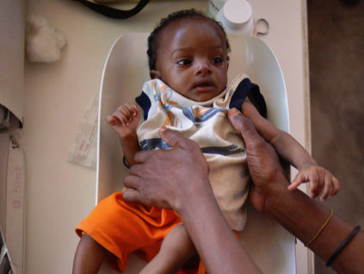
Mohamed
Boy 7 months old
MUAC: 108 mm
Weight: 6.1 kg
Length: 66.3
Oedema: 0
Notes:
No oedema
WHZ: between -3 and -2
But is SAM because MUAC < 115mm
CATEGORY: SAM

Slide 3
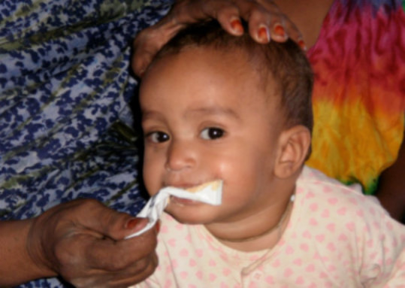
Boy 10 months old
MUAC : 126 mm
Weight: 5.5 kg
Length: 63.1 cm
Oedema= 0
Notes:
No oedema
MUAC > 125= not malnourished
MAM because : Zscore between <-2 and >-3
CATEGORY: MAM

Slide 4
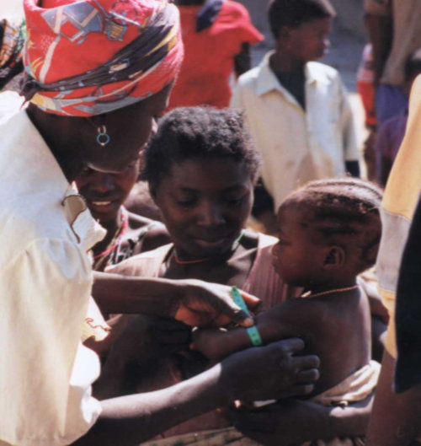
Ninka
Girl 8 months old
MUAC: 131 mm
Weight: 5.9 kg
Length: 62.5 cm
oedema: 0
Notes:
No oedema
Zscore =-1. No malnutrition
CATEGORY: NO MALNUTRITION

Slide 5
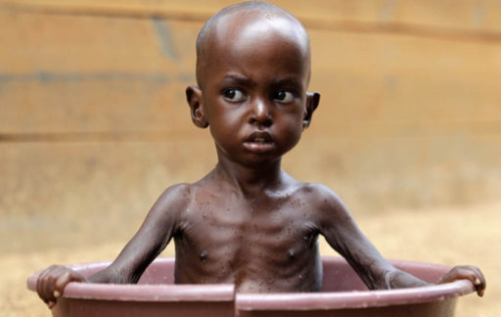
Fabian
Boy 30 months old
MUAC: 120 mm
Weight: 10 kg
Height: 92.2 cm
oedema: 0
Notes:
No oedema
Zscore <-3 SAM
MUAC : MAM
SAM because of WHZ <-3
CATEGORY: SAM

