Slide 1
M1 INITIAL ASSESSMENT
S2 INTERPRETATION

Slide 2
Key Learning Objectives
At the end of this session participants will be able to:
Interpret WHZ index, MUAC cut-offs and severity of bilateral oedema.
Define and classify the types of malnutrition according to WHZ, MUAC and/or oedema.

Slide 3
Initial Questions
What variables do you need to classify acute malnutrition?
Have you ever seen a child with bilateral oedema, how did you recognise it, where were they?

Slide 4
MALNUTRITION INDices
Low weight-for-height/length
=
Acute malnutrition (wasting)
Low height-for-age
=
Chronic malnutrition (stunting)
Low weight-for-age
=
Underweight
Notes:
TUTOR NOTES:
Malnutrition Index
To classify malnutrition, we need different variables: anthropometric measurements (weight, height or length, and MUAC), the clinical sign of bilateral pitting oedema, and the sex and age variables.
These variables in isolation do not provide information on the nutritional status of a person. Measurements such as weight and height have to be seen in relation to each other or in relation to age for interpretation or calculation of indices, which are combinations of measures. In this sense, we use the following indices to classify malnutrition:
Weight/height Z-score (WHZ): To determine acute malnutrition or wasting
Height/age Z-score (HAZ): To determine chronic malnutrition or stunting
Weight/age Z-score (WAZ): To determine underweight (more general nutritional status)
The indices are compared with a reference values (standard cut-off points) to determine if the individual is malnourished and to determine the severity: Moderate or severely malnourished.

Slide 5
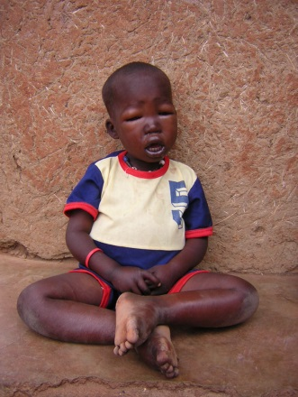
TYPES OF MALNUTRITION
Malnutrition
Micro-nutrient deficiency
Global deficiency
Chronic Malnutrition
Acute Malnutritrion
Stunting
« Too short »
Moderate Acute Malnutrition
Severe Acute Malnutrition
Wasting “Too skinny”
Kwashiorkor “Oedema”

Slide 6
ACUTE MALNUTRITION CLASSIFICATION
Moderate acute malnutrition (MAM) = moderate wasting.
Severe acute malnutrition (SAM) = severe wasting or bilateral edema (can also be both).
Global acute malnutrition refers to both moderate acute malnutrition (MAM) and severe acute malnutrition (SAM).

Slide 7
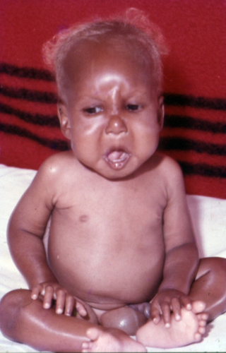
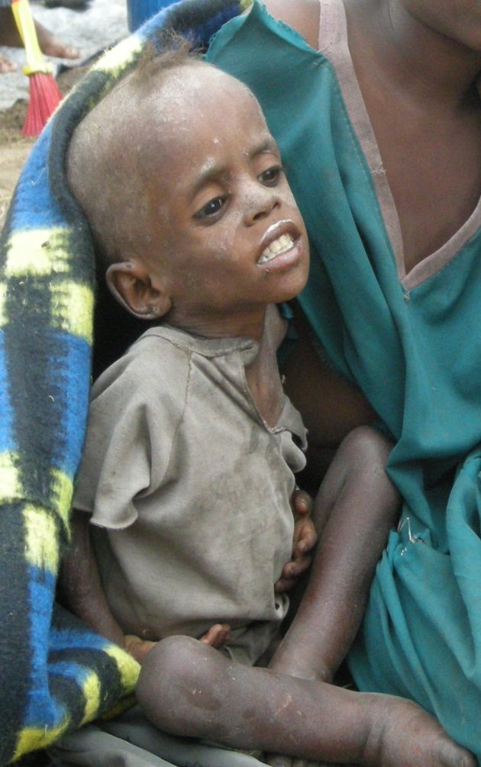
TYPES OF SAM
Marasmus
Kwashiorkor
Marasmus- kwashiorkor
Notes:
There are two types of SAM:
Marasmus:
Excessive thinness, also known as “wasting”.
Low weight compared to height/length (WHZ index criteria) or low MUAC
Resulting from a recent and rapid loss of weight, or incapacity to gain weight
Kwashiorkor:
Presence of bilateral pitting oedema
Often following weaning, 18 months to 2.5 years.
Causes remain uncertain
Note: There are children were both conditions are present: Marasmus (low weight compared to their height/length or low MUAC) + Kwashiorkor (oedema). Often called Marasmic-kwashiorkor or ‘mixed’.

Slide 8
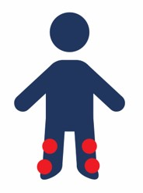
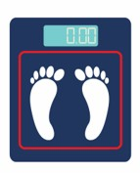
CLASSIFYING NUTRITIONAL STATUS
+
++
+++
Defining the grade of oedema:
if oedema is present in the feet: +
feet and legs: ++
and feet, legs and other parts of the body: +++
Comparing their WHZ to WHO Z-score tables
Compare MUAC to STANDARDISED cut-off criteria
for
Notes:
After measuring each child’s weight, height, length, MUAC and oedema, it is necessary to identify the child’s nutritional status by:
Grading their oedema:
2. Comparing their weight/height index to WHO Z-score tables
3. Compare their MUAC to the cut-off criteria

Slide 9
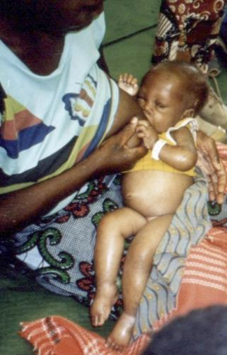
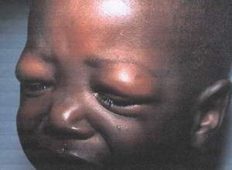
Kwashiorkor: GRADING OEDEMA
Notes:
Grading the severity of oedema:
When bilateral pitting oedema is present: This means that the child has severe acute malnutrition, regardless of their other measurements. This type of malnutrition is called Kwashiorkor.
When measuring oedema, it is important to interpret the grading of bilateral pitting oedema to properly classify its severity. if oedema is present in the feet =+; feet and legs = ++; feet, legs and other parts of the body = +++.

Slide 10
CRITERIA TO DETERMINE ACUTE MALNUTRITION
Acute malnutrition | Criteria
Global Acute Malnutrition (SAM + MAM) | <-2 WHZ (0-59 months) and/or MUAC < 125 mm (6-59 months) And/or Bilateral oedema
Moderate Acute Malnutrition | <-2 to > -3 WHZ (0-59 months) and/or MUAC >115 mm to < 125 mm (6-59 months)
Severe Acute Malnutrition | < -3 WHZ (0-59 months) and/or MUAC < 115 mm (6-59 months) And/or Bilateral oedema
Notes:
Determining the nutritional status
Each variable (MUAC and oedema) or index (WHZ) is independent from the other to classify acute malnutrition. For example: children who present bilateral oedema are diagnosed as SAM, irrespective of their WHZ or MUAC.
Identification of acute malnutrition at community level:
CHW use the MUAC and oedema criteria
SAM and MAM cases will be identified according to MUAC and/or oedema variables

