Slide 1
Get started before going to the field for Nutrition Emergency Interventions
26th-30th September 2022
INTRODUCTION
Núria Salse
La Cooperativa Humanitaria

Slide 2
Learning Objectives
At the end of the course the participants will be able to:
Be familiar with the learning tools and packages ready to use that is available (Nutrition Field Training Package)
Provide training to the MSF clinical staff who will be involved in nutrition programmes in the field.
Describe the different nutrition strategies and the key elements to support the decision-making.

Slide 3
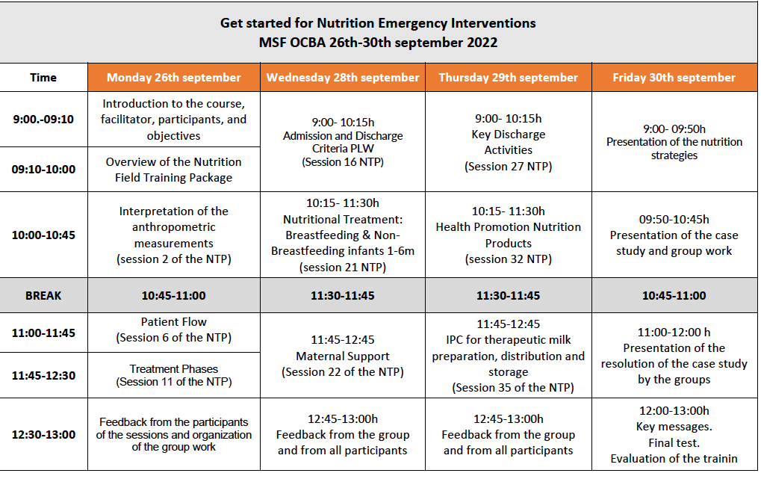
Agenda
Tuesday 27th:
No class
To prepare Wednesday and Thursday’s sessions

Slide 4
TRAINING PLAN
To develop skills and improve learning in your missions

Slide 5
The Learning Cycle
Training Plan (I)
1. Identify learning needs
Identify the staff
Areas of improvement and skills gap
Learning cycle
Notes:
The Facilitator should ask:
How would you recognise or identify learning needs in your teams?
Try and focus the group´s response by using questioning based on multisensory aspects. For example:
What might you observe? (SUPERVISION)
What might you hear?
What might you smell?
What might you feel?

Slide 6
The Learning Cycle
Training Plan (II)
1. Identify learning needs
2. Plan and Design LEARNING
Who is the training for
Learning objectives
Key contents
Prerequisite sessions
Time, schedule
Learning cycle

Slide 7
The Learning Cycle
1. Identify learning needs
2. Plan and Design Learning
3. Facilitate Learning
4.Assess/evaluate Learning
Learning cycle
Ressources: Materials, reference documents, videos…
On the job application
Know your audience!
(danger of assumptions)

Slide 8
Overview of the Nutrition Field Training Package
F2F training
Staff in charge of supervision and training in the field
When:
Starting
Induction
Refresher
Learning tools/packages ready to use
MSF international nutrition protocols

Slide 9
Each module
Facilitator’s Guide
PPT presentation
Additional documents (material and take away messages)

Slide 10
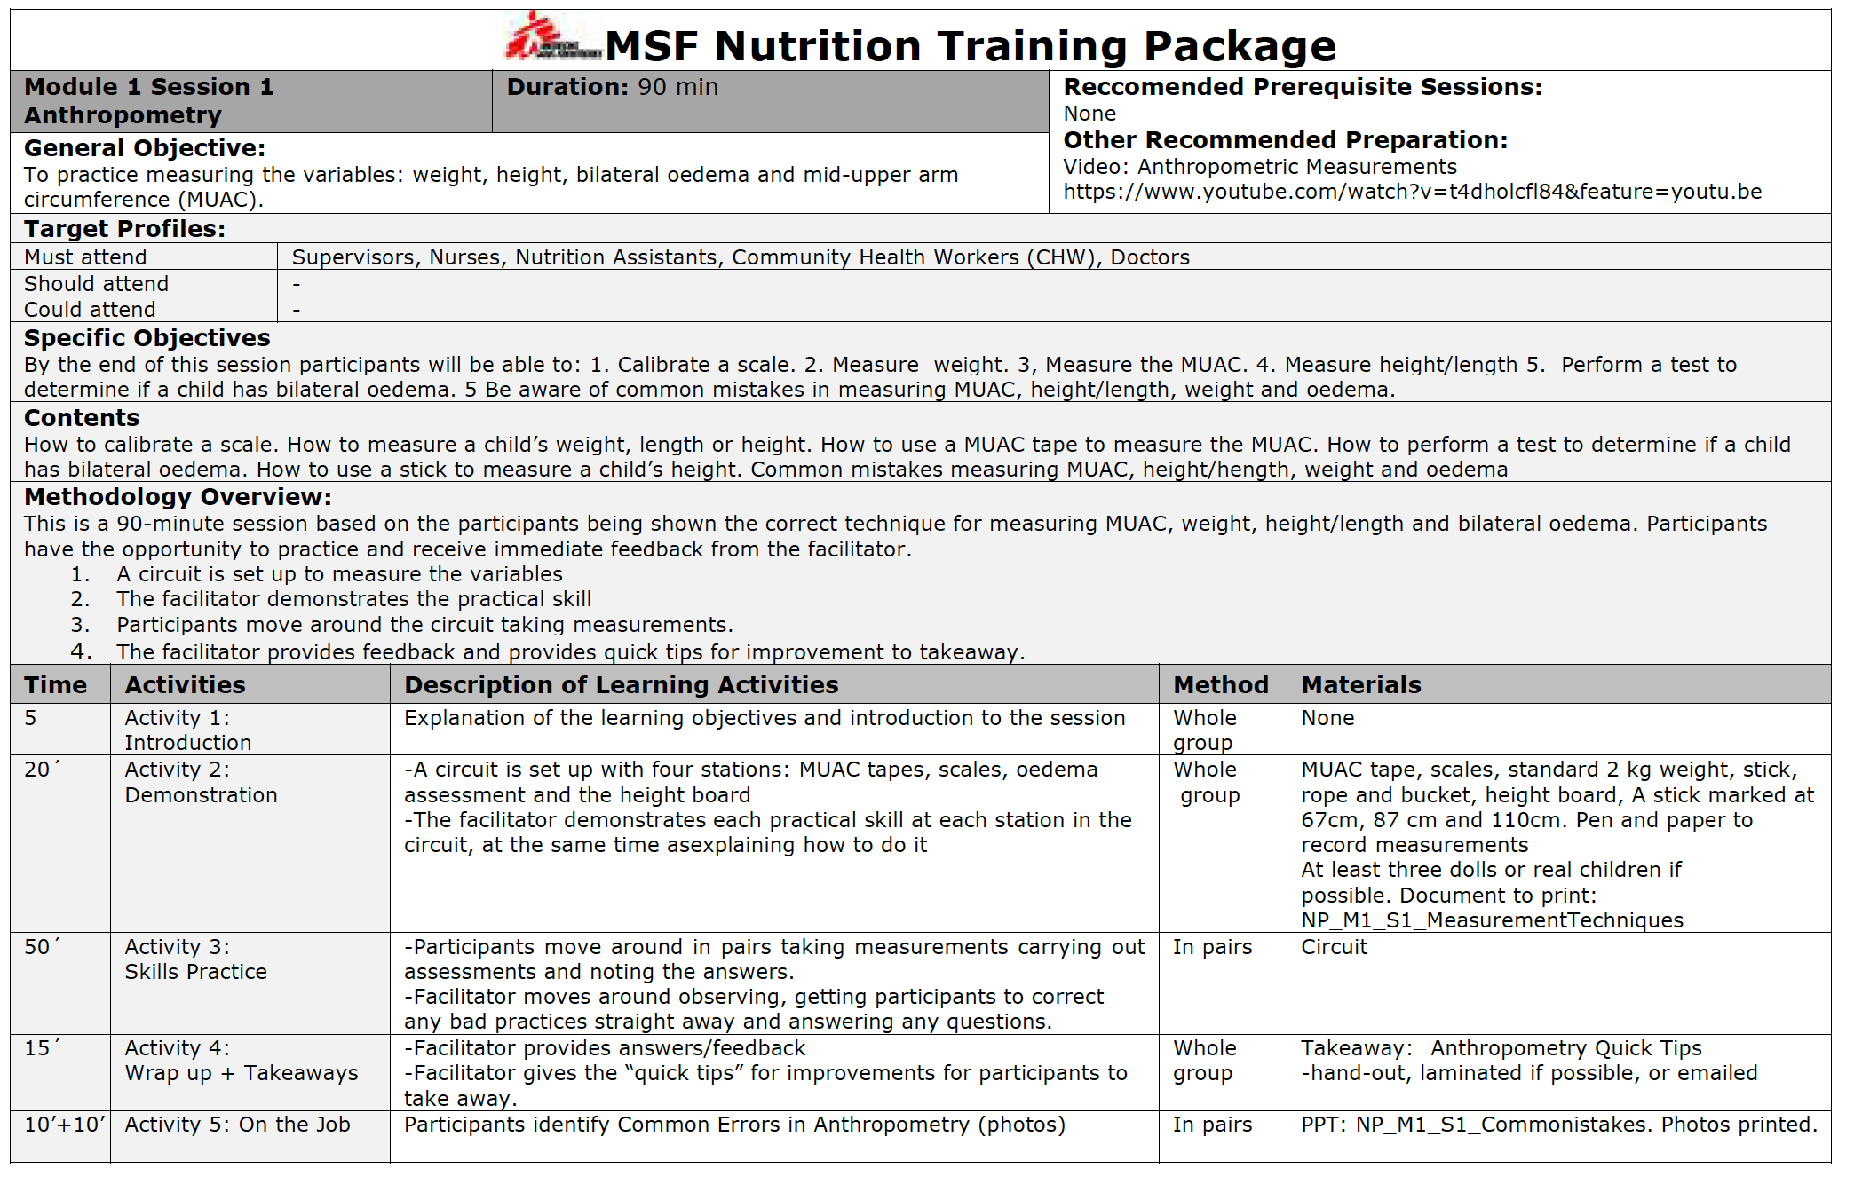
Facilitator Guide

Slide 11
Methodology: 4 steps design
Introduction
Theory
Practice
Wrap up
And…Follow up: On the job training

Slide 12
NTP contents: 11 modules, 41 sessions (40 h)
M1: Initial assessment
M2: Patient flow for decision making
M3: Admission procedure
M4: Case management
M5: PLW management
M6: Infants management
M7: Specific case management
M8: Discharge procedure
M9: Health promotion and community engagement
M10: IPC
M11: Monitoring and evaluation

Slide 13
Let’s start to explore the NTP!

